Slide 1
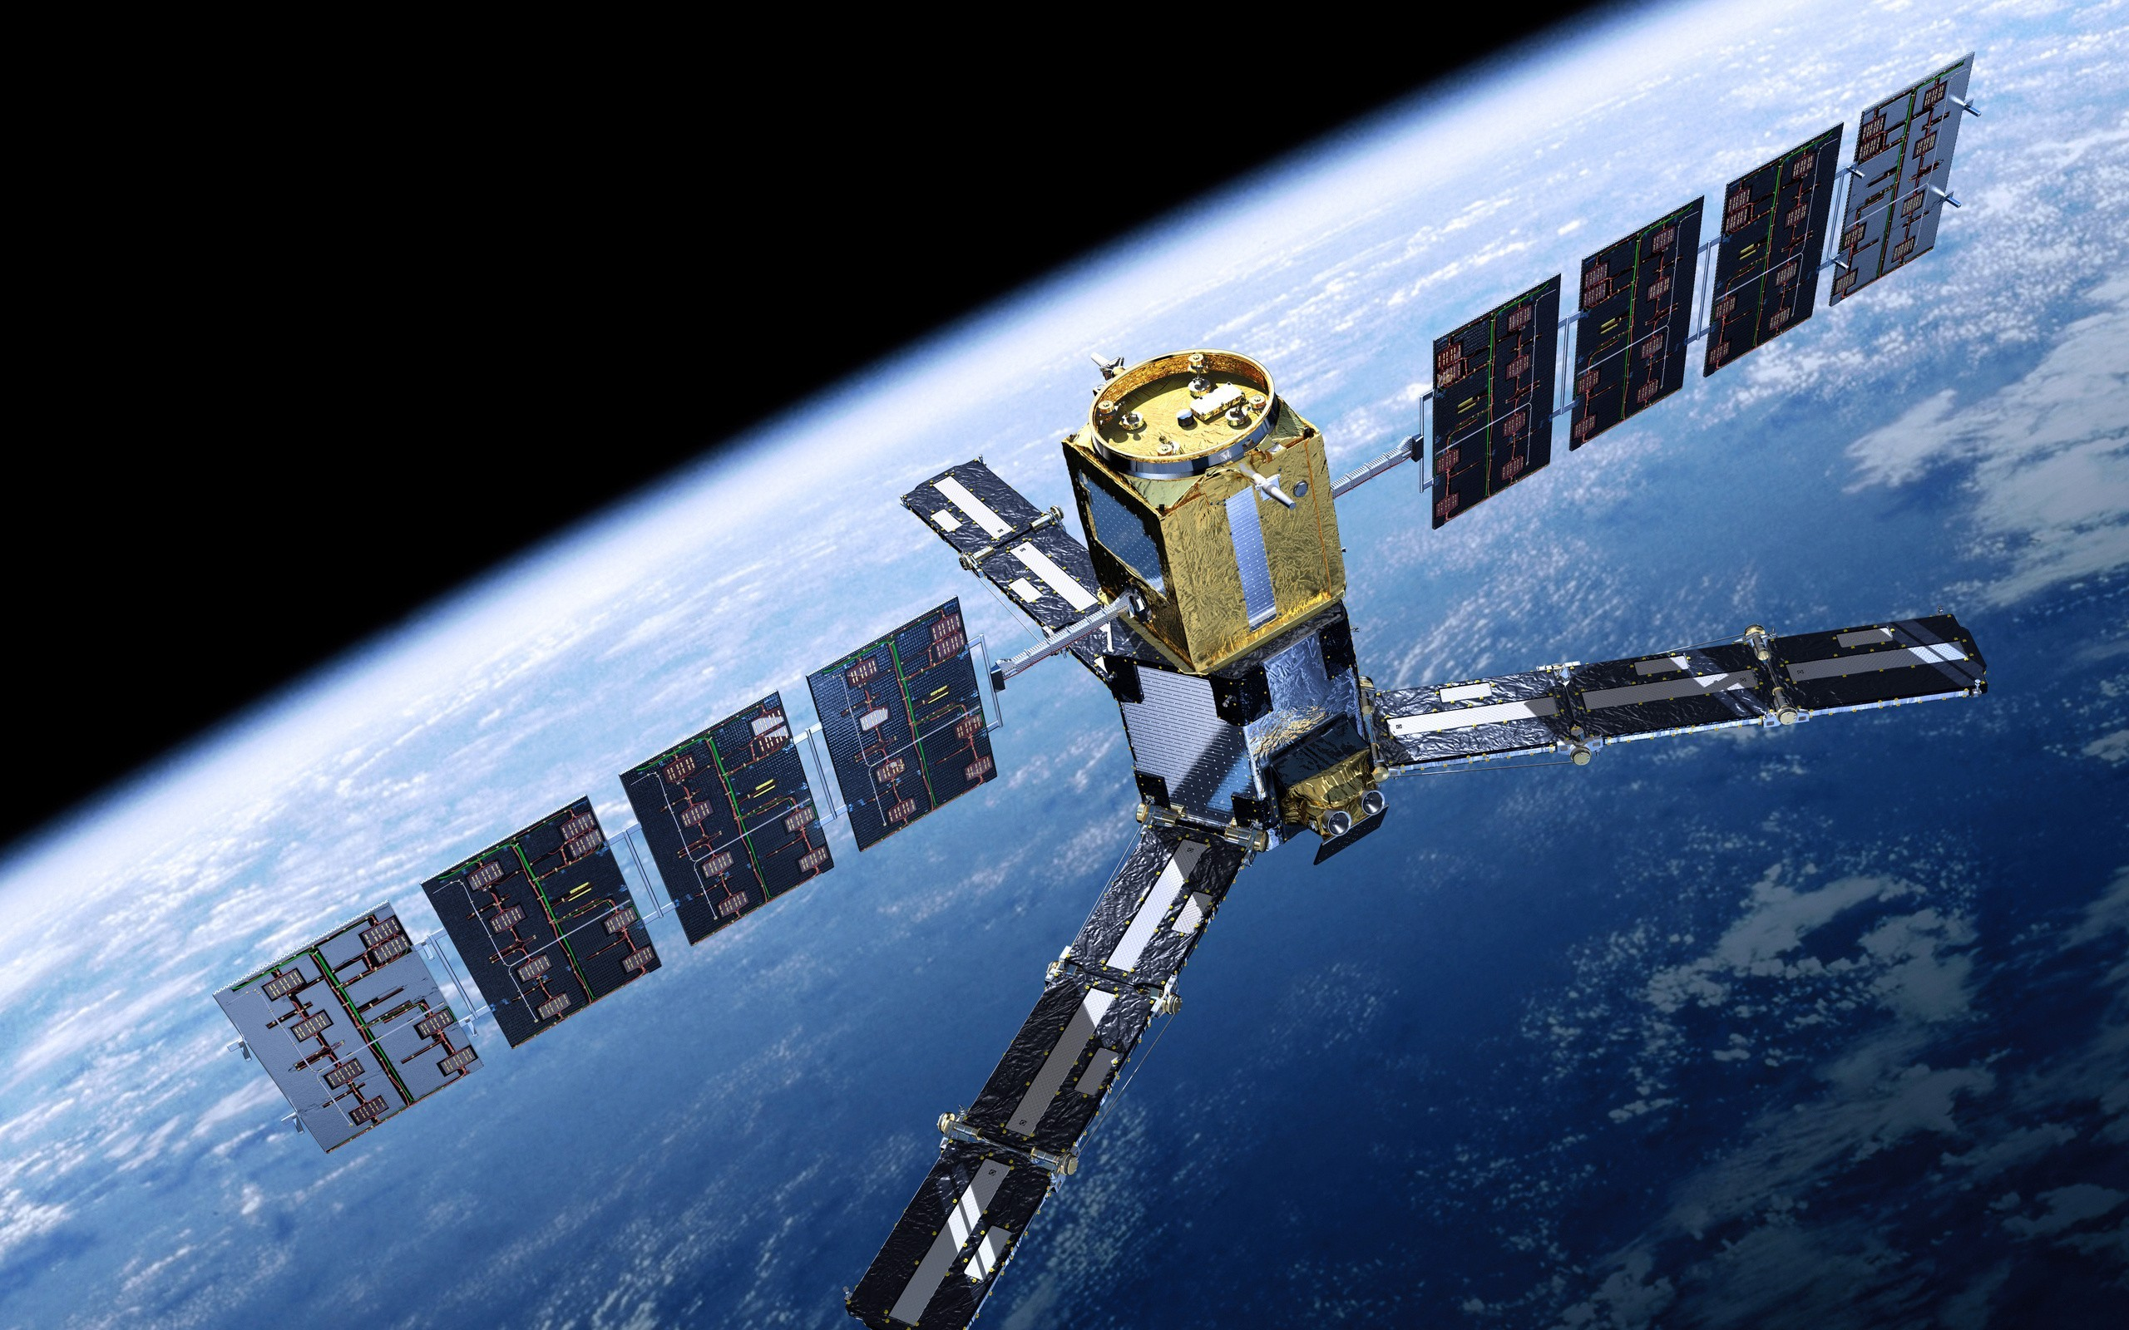
Towards Geospatial Intelligence with AI
Shreya Sharma
Data Science Researcher
NEC Corporation

Slide 2
About Me
From India, working in Japan since Oct 2016
Education
B. Tech. in Electrical Engineering, GBPUAT Pantnagar, India
M. Tech. in Geoinformatics Engineering, IIT Bombay, India
Professional Experience
Data Science Researcher in NEC (3 years)
Image Processing Lab Teaching Assistant in IIT Bombay (1 year)
Research Achievements
3 Patents
5 Publications in top-level remote sensing conferences- IGARSS, SPIE
Foreign collaborations
Hobbies
Blogging
Social Activities
Volunteer at Hands-on-Tokyo NGO
Speaker at Machine Learning Tokyo

Slide 3
Career Interests
Research Topics
Domains
Computer Vision
Image Processing
Deep Learning
Statistical Analysis
Geospatial
Healthcare
E-commerce
Agriculture
Security

Slide 4
Overview of My Projects
Research Projects at NEC
Ship Classification for Maritime Surveillance
Small Object Change Detection in Time-series of Images
Land-use Land-cover Segmentation in Large-size Satellite Images
Master’s Thesis
Hyperspectral Image Super-resolution
Academic Projects
Dimensionality Reduction of Hyperspectral Images
Shape Detection using Hit and Miss Transform
Optimal Bike Path Development and Route Prediction
Feature extraction using Active Contour Models
More Information at: https://shreya1sharma.github.io/ShreyaSharma/projects/

Slide 5
Today I will present
Ship Classification for Maritime Surveillance
Change Detection in Time-series of Images
Current Work and Challenges
Collaboration Activities
Case Study: Brain Tumor Segmentation with MRI

Slide 6
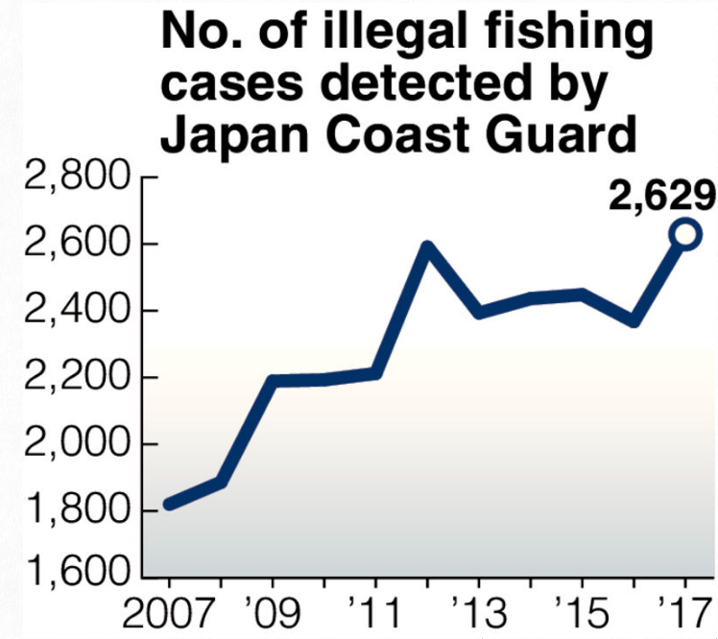
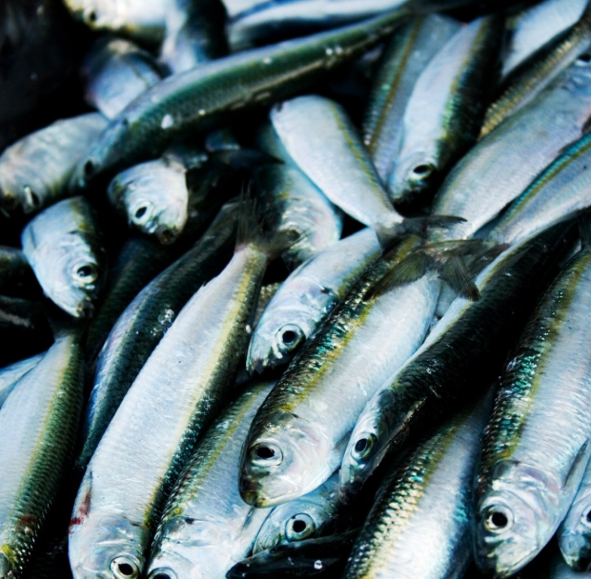
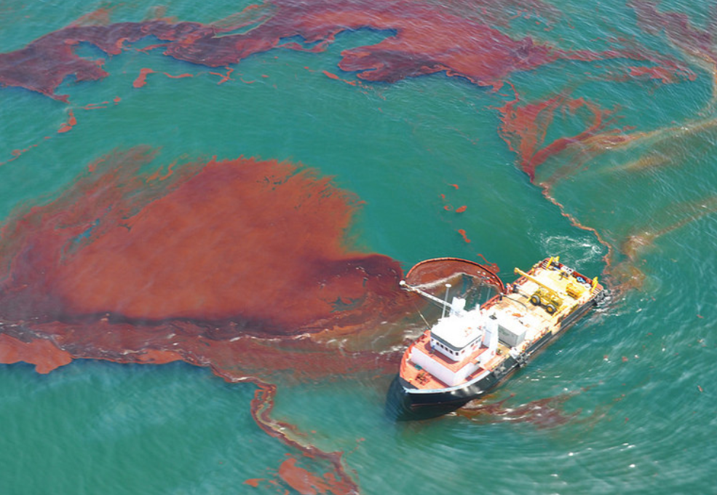
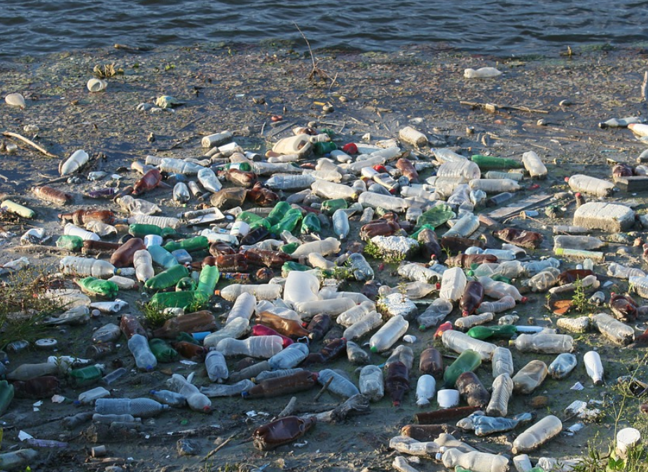
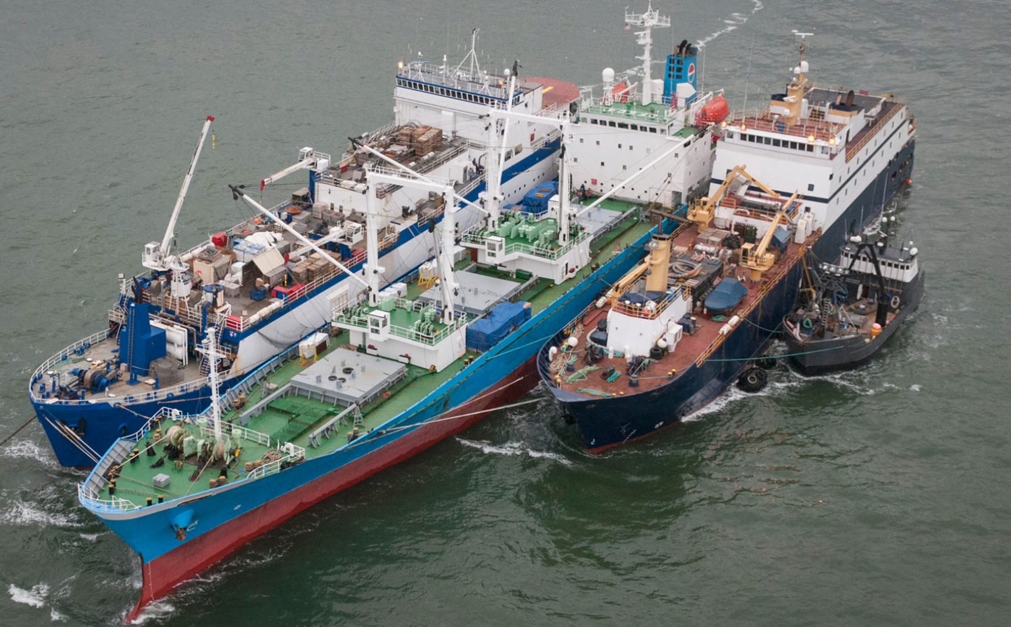
Motivation
Ship Classification is a key application in maritime surveillance
Helps in quick identification of ships involved in illegal activities
Overfishing
Oil-spills
© NOAA/CC BY 2.0
Garbage dump
Smuggling
©Yomiuri Shinbun, 28/02/2018
$US23 billion loss worldwide per year!
© Nature Magazine

Slide 7
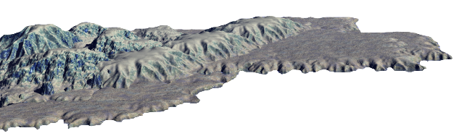
Ship Classification from Space
3 major sources of information : AIS, Visible and Microwaves
Microwaves can see ships undetected/spoofed by AIS and Visible
Automatic Identification System (AIS)
Visible
Undetected due to cloud
Microwaves
Can be easily spoofed by owner
Cannot hide
All time monitoring
Microwave images are highly reliable for ship classification

Slide 8
Conventional Methods
1. Hand-crafted feature (HCF)-based
Bounding Box
Feature extractor*
Classifier (SVM)
Class
© JAXA
*Length, Area, Intensity, … etc.
2. Convolutional Neural Network (CNN)-based
CNN
Class
© JAXA
Sharma et al., Comparative Analysis of feature extraction approaches for ship classification in moderate resolution SAR imagery, IEEE IGARSS 2018.
These methods classify a ship based on its appearance in image

Slide 9
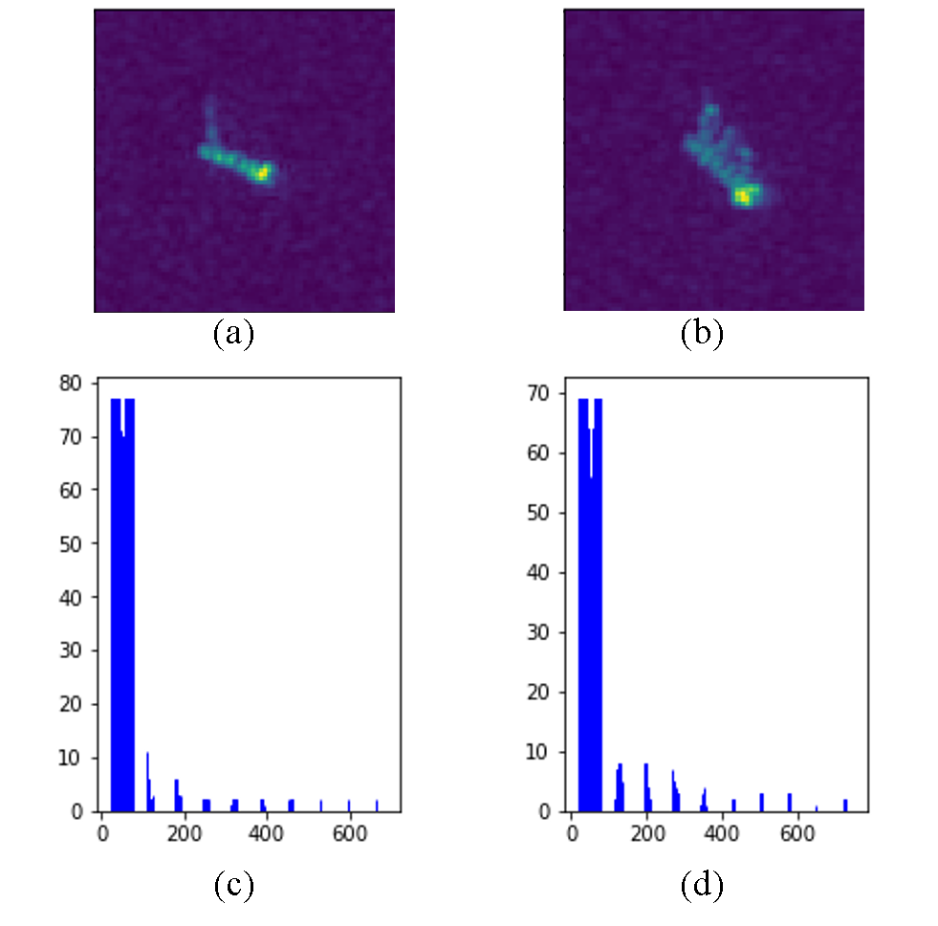
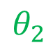

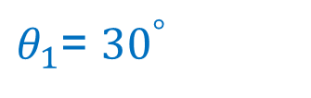
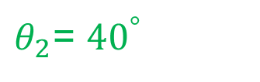
Problem
Appearance of a ship varies with satellite viewing angle
Labelled microwave images are very few to learn all possible variations
Example:
$θ_{1}$= ${30}^{°}$
Satellite
Range
$$θ_{1}$$
$$θ_{2}$$
Same ship viewed under different angles
© JAXA
$θ_{2}$= ${40}^{°}$
Azimuth
© JAXA
Only image information is insufficient for robust classification
Notes:
Explain briefly what is SAR geometry
For cnn to learn all these variations, huge training data is required, but it is not available in SAR.

Slide 10
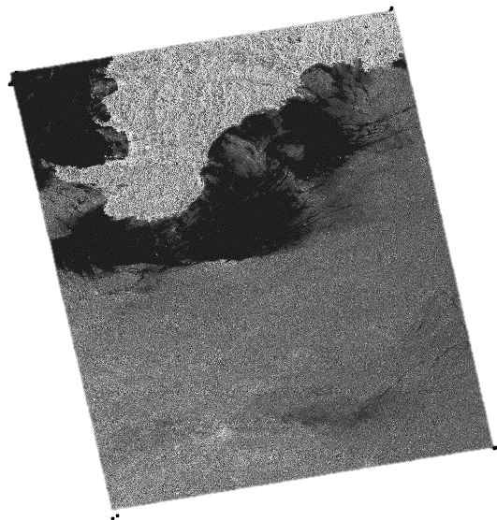



Proposed Method
Use viewing angle as an additional information in a NN
Helps the CNN to follow the appearance changes by learning a relationship
Image
Ship Images
CNN
Ship Class
© JAXA
© JAXA
Viewing angle map
Shows viewing angle at each pixel
Metadata
Extract Viewing Angle Map
$${40}^{°}$$
$${25}^{°}$$
Sharma et al., CNN-based ship classification method incorporating SAR geometry information, SPIE RS 2018.

Slide 11
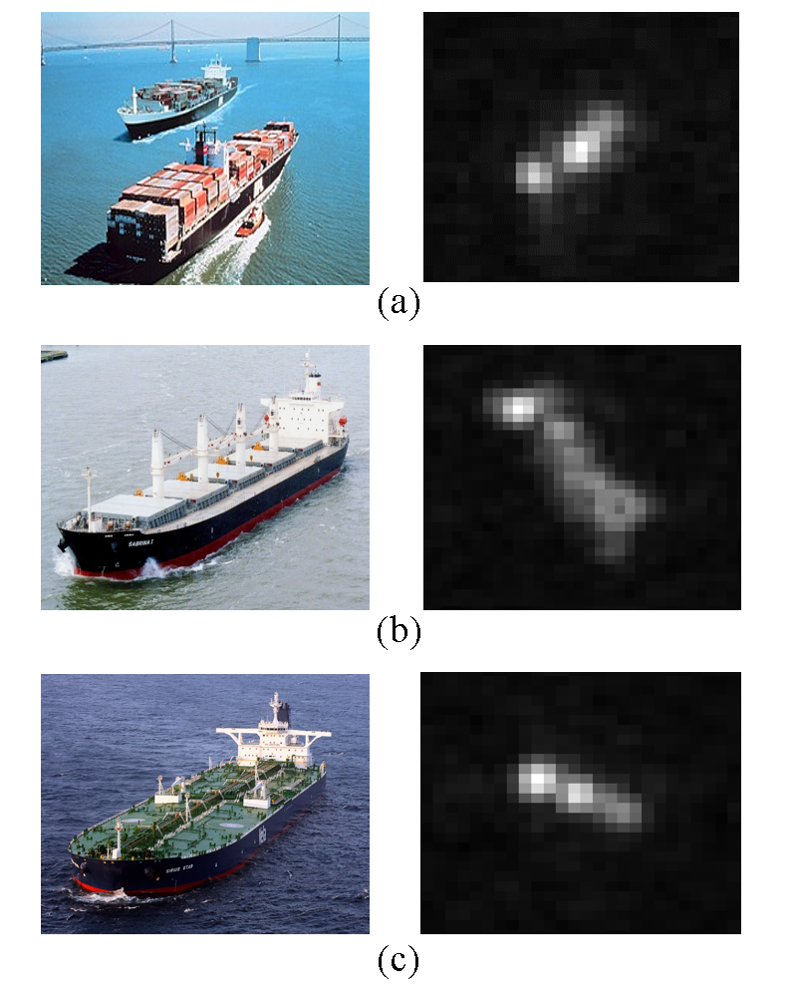
Experiments
Dataset: OpenSARShip*
Specifications
Satellite | Sentinel-1
Resolution | 20m
Image size | 128 x 128
No. images | 200 per class
Ground truth | AIS + Marine Traffic
Container
© NOAA
© ESA
© ESA
Bulk-carrier
Conventional Methods
© ESA
HCF | 10 Features + SVM
CNN | w/o incident angle
Tanker
Metrics
© ESA
f-measure | Higher is better
#training data needed | Lower is better
© ESA
*Huang, L et al., "OpenSARShip: A dataset dedicated to Sentinel-1 ship interpretation," IEEE Journal of Sel. Top. in App. Earth Obs. and Rem. Sen. 11(1), 195-208 (2018).

Slide 12
Results
4.2% improvement in
f-measure
25% reduction in
training data requirement
© ESA
Same Acc.
© ESA
© ESA
Proposed method outperforms the conventional methods

Slide 13
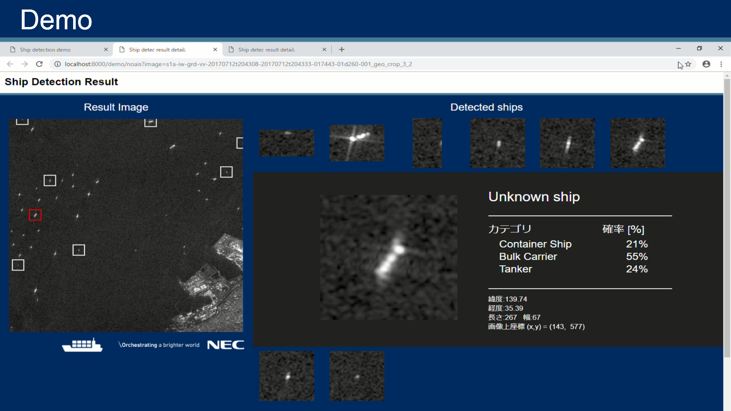
Demo Example

Slide 14
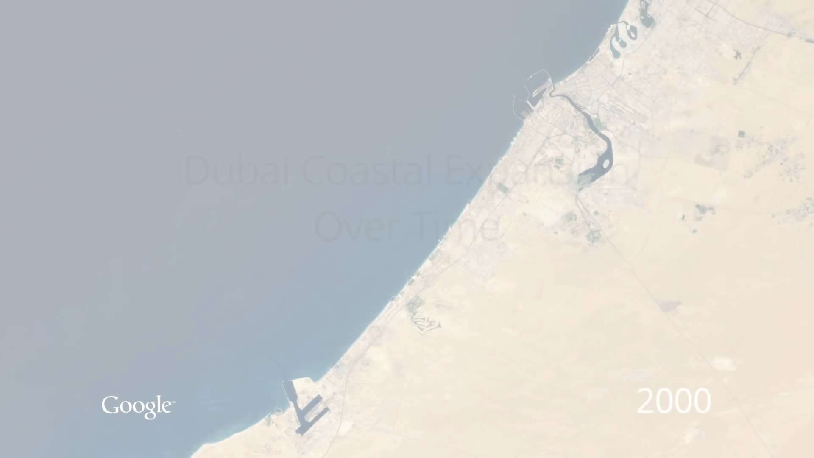
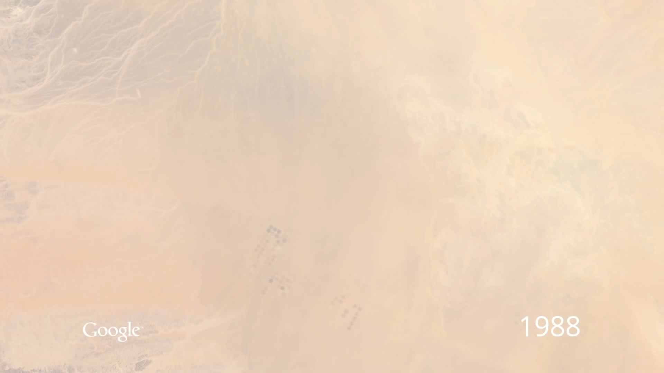
Motivation
Change detection enables us to understand dynamics of Earth
Dubai Coastal Expansion
Saudi Arabia Irrigation

Slide 15
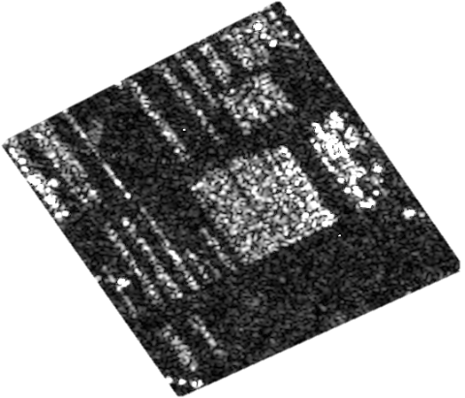
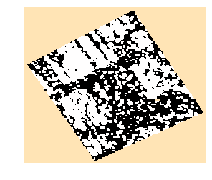
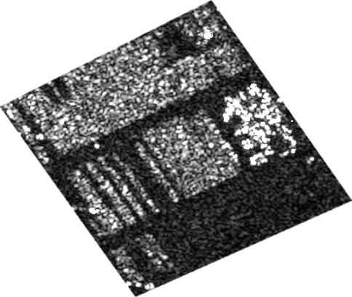
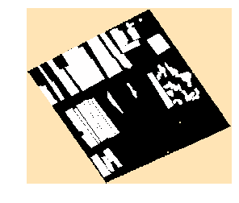
Conventional Method
Based on pixel-to-pixel difference followed by classification
Before Image
Change Map
Pixel-to-pixel difference
Classification
After Image
Ground Truth
Problem:
Many False Alarms!

Slide 16
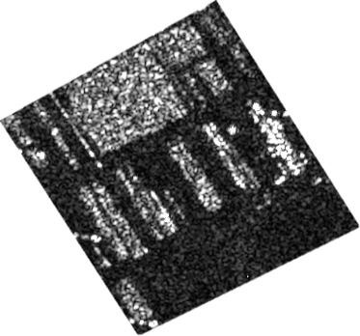
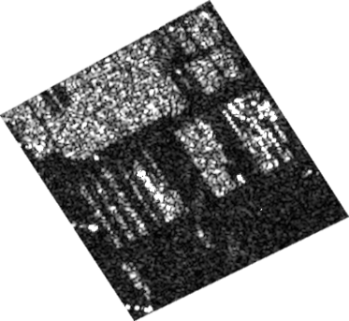

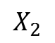
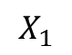
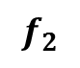
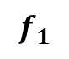
Proposed Method
Transform the images into features and compute difference between features
SAR Image $1$
Siamese Network
TRAINING
Conv
Conv
Pool
Conv
FC
FC
$$f_{1}$$
$$X_{1}$$
Patch Extraction
Distance Loss
Share Weights
Y true
SAR Image $2$
Conv
Conv
Pool
Conv
FC
FC
$$X_{2}$$
$$f_{2}$$
TESTING
Change Map
Trained Siamese
Distance Calculation
Thresholding
Sharma et al., Very high resolution SAR change detection with Siamese Networks, The 66th Academic Conference of the Remote Sensing Society of Japan, 2019.

Slide 17
Experiments : Parking Lot Monitoring
…
Specifications
TerraSAR-X satellite
1m resolution
Baselines:
PCA-K [1]
SAE-K [2]
Evaluation Metrics
f-measure
Change Maps
[1] T. Celik: Unsupervised change detection in satellite images using principal component analysis and k-means clustering, IEEE Geoscience and Remote Sensing Letters, vol. 6, no. 4, pp. 772-776, 2009.
[2] M. Gong., H. Yang, and P. Zhang: Feature learning and change feature classification based on deep learning for ternary change detection in SAR images, ISPRS Journal of Photogr. and Remote Sensing, no.129, pp.212-225, 2017.
Dataset
t1
t2
t3
t9
t10
…
Site 1
…
Site 2
…
…
Site 3
Site 4
…
All images are copyrighted to DLR
…
Test
Site 5
Pair 1
Pair 2
Pair 9

Slide 18
Result [1/2] : f-measure
Proposed method improves f-measure by 15% over baselines
+0.04
+0.25

Slide 19
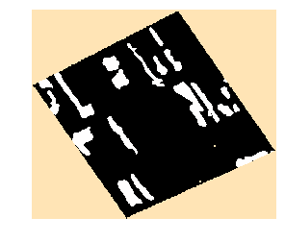
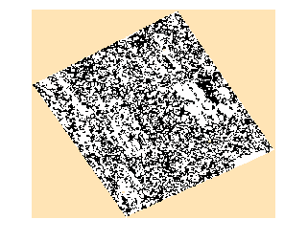
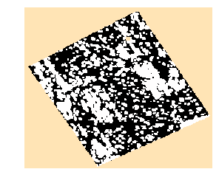
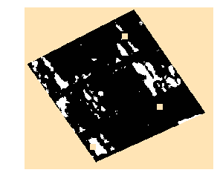
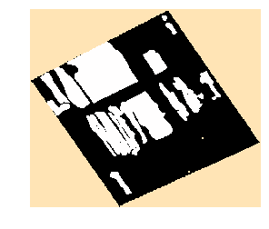
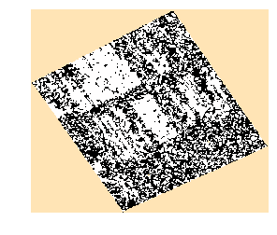
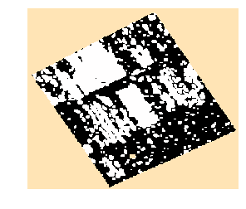
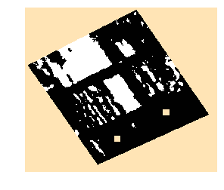
Result [2/2] : Change Maps
Proposed method produces visually better change maps
Ground Truth
PCA-K
SAE-K
Proposed
Pair 1
Pair 2

Slide 20
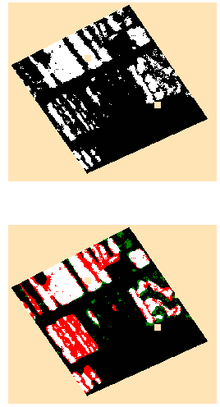
Current Work: Improving Proposed Network
False Negatives show that many foreground areas are undetected
Colorized Change Map
Legend: TP, TN, FP, FN
Research Question: Can we improve the detection of foreground?
Feasible solution: Use additional information about foreground and background

Slide 21
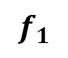
Proposed Method : Multitask Siamese Network
Add classification task as a support to change detection task
SAR Image $1$
TRAINING
Siamese Network
Cross-entropy Loss
Conv
Conv
Pool
Conv
FC
FC
$$f_{1}$$
$$X_{1}$$
Patch Extraction
Distance Loss
Combine Loss
Share Weights
SAR Image $2$
Conv
Conv
Pool
Conv
FC
FC
Cross-entropy Loss
$$X_{2}$$
$$f_{2}$$
TESTING
Change Map
Trained Multitask Siamese
Distance Calculation
Thresholding

Slide 22
Collaboration Activities
Actively initiated several foreign and domestic collaborations
Institute | Outcome
European Remote Sensing Firm | Exhaustive feedback from an expert and knowledge of remote sensing business model
INRIA France | Built strong connection with foreign academia on ship classification project
University of Trento Italy | Built strong connection with foreign academia on change detection project
NEC Labs Europe | Initiated cross-lab collaboration opportunity
AIST Japan | Special lecture series by renowned professor and created data selling opportunity
Kyushu University | Feedback on the current change detection project and obtained useful references

Slide 23
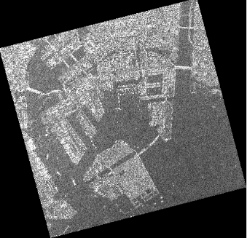
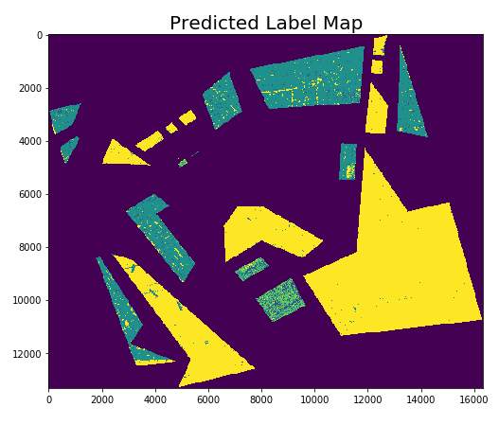
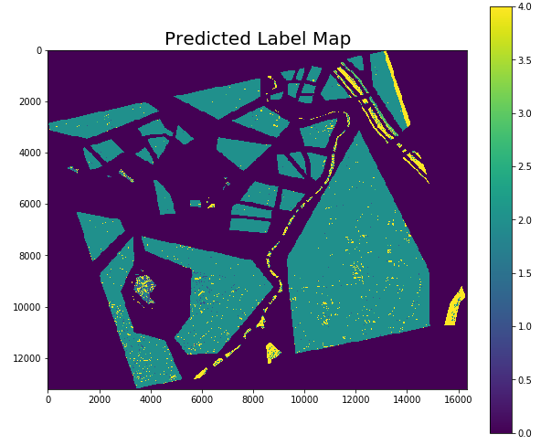
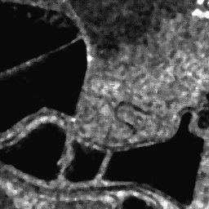
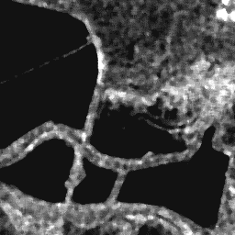
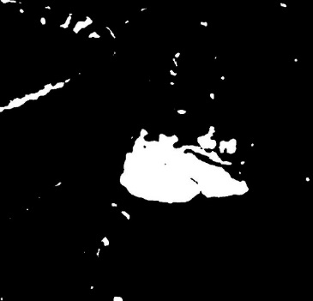
Today I will present
Ship classification for maritime surveillance
Land-cover segmentation in large-size images
Change detection in multi-time images and current work
Collaboration and business initiatives
Case study on brain tumor segmentation with MRI
Container
Bulk-carrier
Tanker
© ESA
© ESA
© ESA
Image
Prediction
Background
Settlement
Barefield
Forest
Water
Before Image
After Image
Change Map
© ESA
© ESA

Slide 24
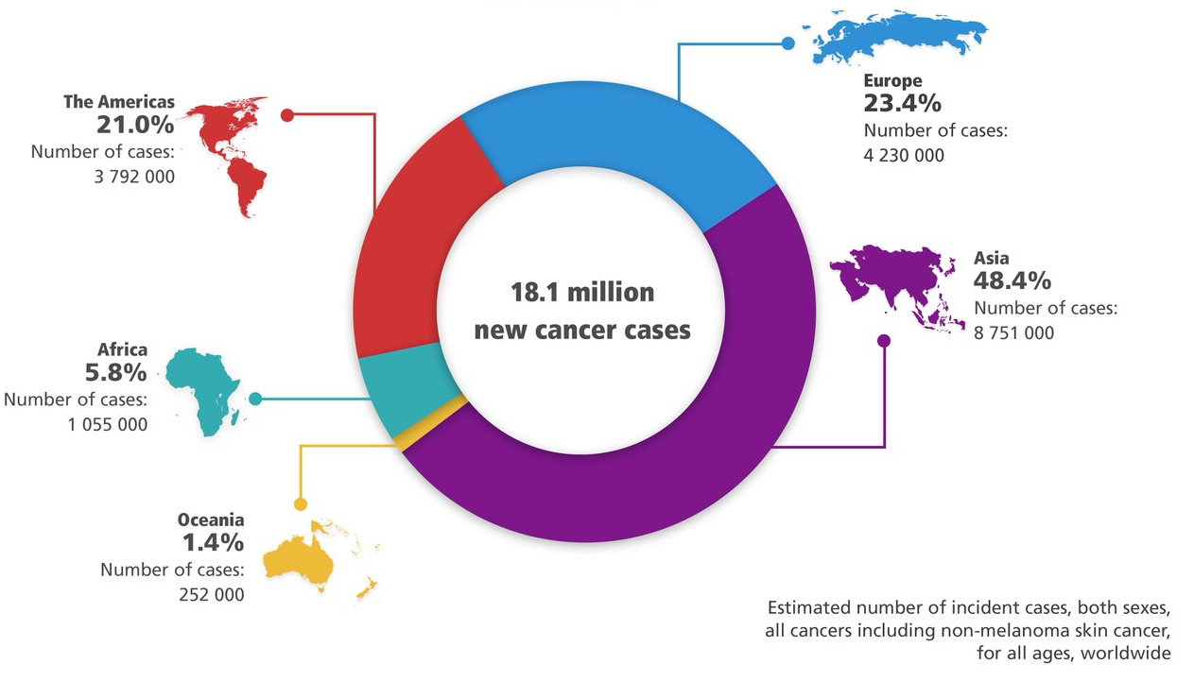

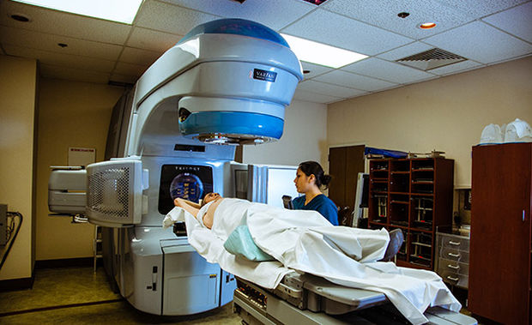
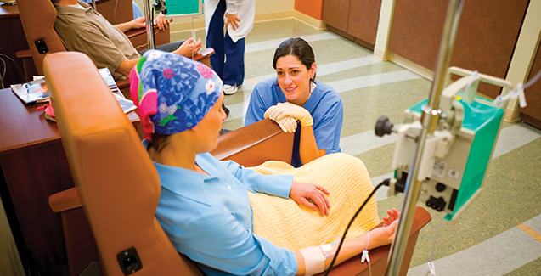
Motivation
50,000+ new brain tumor cases are reported in India each year
20% are children, tumor kills more children than any other disease
2018 Global Cancer Incidence
Treatments
SURGERY
RADIATION
CHEMO
Only 51% success
Very painful
Highly expensive
©GLOBOCON
90% cases could been cured if detected early and correctly

Slide 25
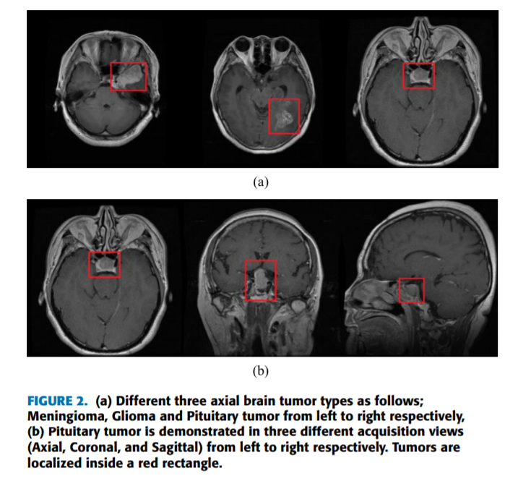
Brain tumor and its types
Brain tumor is a lump created by abnormal growth of cells in brain
Types
Primary
Secondary
Meningioma
Pituitary adenoma
Glioma
Non-cancerous
Easy to detect
Originate in brain
Non-cancerous
Easy to detect
Originate
somewhere else
Lung (50%)
Breast (15%)
Melanoma (10%)
Cancerous
Difficult to detect
Diffused structure and poor contrast
Accurate glioma segmentation is needed to detect brain cancer

Slide 26
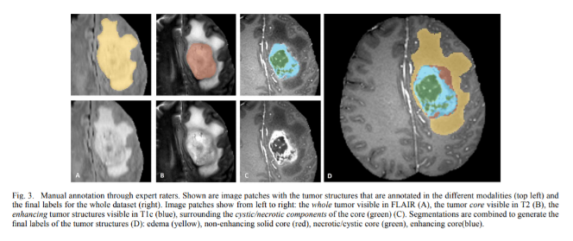
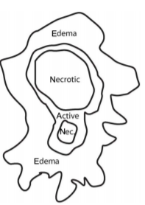
Role of MRI images
Provides unique information about different glioma segments
MRI has high-resolution imaging quality and many modalities
Glioma Segments
MRI showing glioma segments
FLAIR
T2
T1
Edema
Non-enhancing core
Complete
Core
Enhance
Enhancing core
Necrotic
MRI images are highly suitable for glioma segmentation

Slide 27
Challenges in MRI-based Brain Tumor Segmentation
3 categories of challenges
1. MRI Artifacts | 2. Glioma Features | 3. Dataset
Noise Intensity inhomogeneity Non-standardized scale | Shape, size and location unpredictable Tumor cells affect nearby healthy cells | Huge image size Imbalanced dataset Variation in expert labelling

Slide 28
Challenges in MRI-based Brain Tumor Segmentation
3 categories of challenges
1. MRI Artifacts | 2. Glioma Features | 3. Dataset
Noise Intensity inhomogeneity Non-standardized scale | Shape, size and location unpredictable Tumor cells affect nearby healthy cells | Huge image size Imbalanced dataset Variation in expert labelling
Please Note: In this case study, I focus on presenting a feasible solution, and NOT on finding a research gap due to limited time.

Slide 29
Challenges in MRI-based Brain Tumor Segmentation
3 categories of challenges
1. MRI Artifacts | 2. Glioma Features | 3. Dataset
Noise Intensity inhomogeneity Non-standardized scale | Shape, size and location unpredictable Tumor cells affect nearby healthy cells | Huge image size Imbalanced dataset Variation in expert labelling
MRI Pre-processing

Slide 30
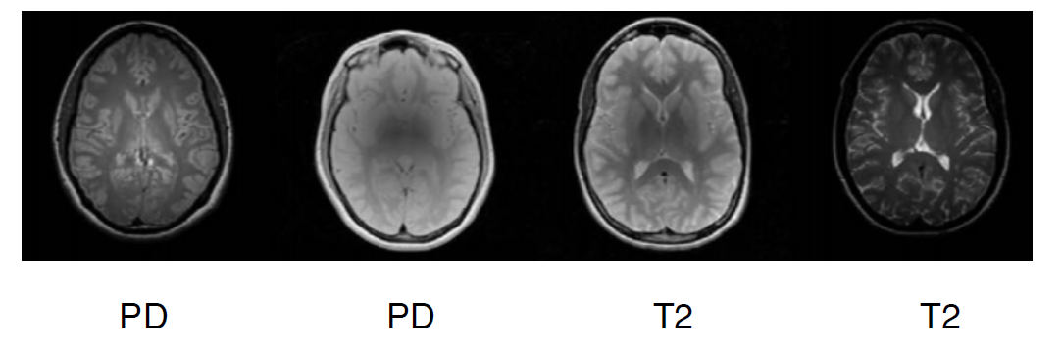
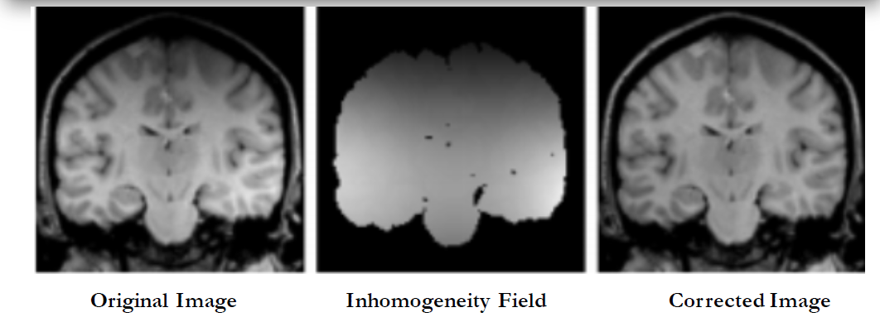

MRI Pre-processing
Noise Removal
Intensity Homogeneity
Intensity Standardization
To remove intensity variations caused by difference in magnetic field
To standardize intensity scales varied due to different acquisition times
To improve contrast between brain tissues

Slide 31
Challenges in MRI-based Brain Tumor Segmentation
3 categories of challenges
1. MRI Artifacts | 2. Glioma Features | 3. Dataset
Noise Intensity inhomogeneity Non-standardized scale | Shape, size and location unpredictable Tumor cells affect nearby healthy cells | Huge image size Imbalanced dataset Variation in expert labelling
MRI Pre-processing
Convolutional Neural Network
Patch Extraction
Data Augmentation

Slide 32

Solution
TRAINING PHASE
Loss function
TRAIN IMAGES
TRUE LABELS
FLAIR
T2
T1
MRI Pre-processing
Patch extraction
Data Augmentation
CNN
TEST
IMAGES
TESTING PHASE
PREDICTED LABELS
FLAIR
T2
MRI Pre-processing
Patch extraction
Trained CNN
Post-processing
T1

Slide 33


Experimental Set-up for Evaluation
Dataset- BraTS MICCAI
Evaluation Metric
Dice Coefficient
Specificity
Sensitivity

Slide 34
Future Directions
Incorporating blood reports
Glioma grading – grade 1,2,3,4
3D CNN’s for handling voxels

Slide 35
References
Course on fundamentals of medical image analysis
CAP5516- Medical Image Computing, Prof. Ulas Bagci, UCF
Survey research papers
Litjens, Geert, et al. "A survey on deep learning in medical image analysis." Medical image analysis 42 (2017): 60-88.
Lundervold et al., An overview of deep learning in medical imaging focusing on MRI (2019), https://arxiv.org/abs/1811.10052
Brain tumor segmentation papers
Akkus, Zeynettin, et al. "Deep learning for brain MRI segmentation: state of the art and future directions." Journal of digital imaging 30.4 (2017): 449-459.
Havaei, Mohammad, et al. "Brain tumor segmentation with deep neural networks." Medical image analysis 35 (2017): 18-31.
Pereira, Sérgio, et al. "Brain tumor segmentation using convolutional neural networks in MRI images." IEEE transactions on medical imaging 35.5 (2016): 1240-1251.
Menze, Bjoern H., et al. "The multimodal brain tumor image segmentation benchmark (BRATS)." IEEE transactions on medical imaging 34.10 (2014): 1993-2024.
Cancer statistics
Global Cancer Observatory https://gco.iarc.fr/today/home
http://cancerindia.org.in/globocan-2018-india-factsheet/

Slide 36
Conclusion

Slide 37
Brain tumor and its types
Brain tumor is a lump created by abnormal growth of cells in brain
Types
Primary
Secondary
Meningioma
Pituitary adenoma
Glioma
Non-cancerous
Easy to detect
Originate in brain
Non-cancerous
Easy to detect
Originate
somewhere else
Lung (50%)
Breast (15%)
Melanoma (10%)
Cancerous
Difficult to detect
Diffused structure and poor contrast
Accurate glioma segmentation is needed to detect brain cancer

Slide 38
Challenges in MRI-based Brain Tumor Segmentation
4 categories of challenges
MRI Artifacts
Noise
Intensity non-homogeneity
Intensity non-standardized scale
Glioma characteristics
Size, shape and location of glioma is unpredictable
Tumor mass effect the arrangement of surrounding normal tissue
Labels
Manual segmentation by experts show significant variations
Imbalanced data (healthy voxel comprise 98% of total voxels)
Huge image size

Slide 39

Motivation
50,000+ new brain tumor cases in India are reported each year
2500 children per year i.e. 20% are children
Kills more children than any other disease
Current methods to treat are – surgery, chemotherapy, radiotherapy -> late detection
90% of the cases would have been cured if detected early and correctly
So an efficient automatic brain tumor segmentation system is needed
1.2 million

Slide 40
My approach to enter medical image analysis field
Basics of medical image processing
Overview of deep learning in medical image analysis
Overview of deep learning in MRI analysis
Brain tumor segmentation using MRI
My solution

Slide 41
MRI-based brain tumor segmentation methods
Methods
Template-matching
Classical Machine Learning
Deep Learning
Shallow CNN
3D filters
TwoPathway
CascadedCNN

Slide 42
Contents
About Me (1)
Career Interests (1)
Projects Overview (1)
SAR
Ship Recognition Project (4-objective, conventional + problem, proposed, results)
Land Cover Segmentation Project (4)
Change Detection Project (4)
Current work – Multitask learning for change detection(2-problem, solution, challenges)
Collaborations and Business activities (1)
Problem-Brain Tumor Segmentation
Approach to learn new field (1)
Why MRI? (1)
Brain Tumor Segmentation – Motivation (1)
My proposed method (1)
How would I evaluate (1)
Conclusion (1)

